Slide 1
Chapter 16-2. MOS electrostatic: Quantitative analysis
In this class, we will
Derive analytical expressions for the charge density, electric field and the electrostatic potential.
Expression for the depletion layer width
Describe delta depletion solution
Derive gate voltage relationship
  Gate voltage required to obtain inversion

Slide 2
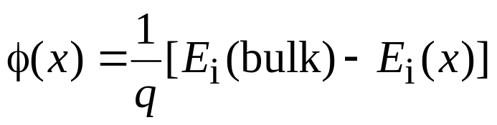
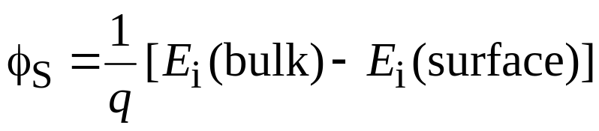
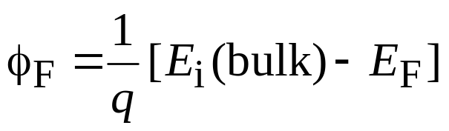
Electrostatic potential, φ(x)
Define a new term, φ(x) taken to be the potential inside the semiconductor at a given point x. [The symbol φ instead of V used in MOS work to avoid confusion with externally applied voltage, V]
Potential at any point x
Surface potential
| φ_{F} | related to doping
concentration
φ_{F} > 0 means p-type φ_{F} < 0 means n-type

Slide 3
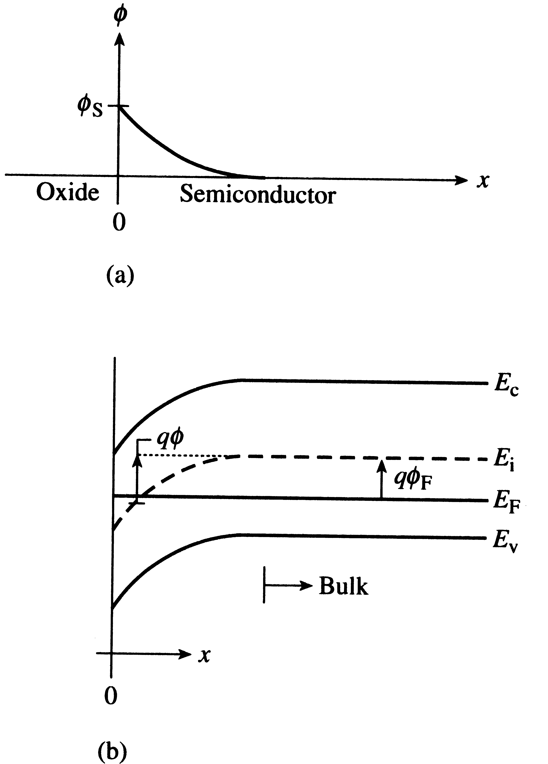
Electrostatic parameters
φ_{S} is positive if the
band bends downward
φ_{S} = 2φ_{F} at the
depletion-inversion
transition point

Slide 4
Example 1
Consider the following φ_{F} and φ_{S} parameters. Indicate whether the semiconductor is p-type or n-type, specify the biasing condition, and draw the energy band diagram at the biasing condition.
(i) φ_{F} = 12 kT/q; φ_{S} = 12 kT/q
φ_{F} = +12 kT/q means that E_{i} – E_{F} in the semiconductor is 12 kT (a
positive value); So, p-type. N_{A} = n_{i} exp [(E_{i} – E_{F} ) / kT]
φ_{S}=12 kT/q means E_{i} (bulk) – E_{i}(surface) = 12 kT; i.e. the band bends downward near the surface.
E_{C}
E_{i}
E_{F}
E_{V}
12kT

Slide 5
Example 1 (continued)
(ii) φ_{F} = − 9 kT/q; φ_{S} = −18 kT/q
here φ_{F} = − 9 kT/q means [E_{i}(bulk) – E_{F}] = − 9 kT; i.e., E_{i} is below E_{F}. Thus the semiconductor is n-type.
φ_{S}= − 18 kT/q means that E_{i} (bulk) – E_{i}(surface) = –18 kT; So band
bends upwards near the surface. The surface is “inverted” since
the surface has the same number of holes as the bulk has electrons.
E_{C}
E_{F}
E_{i}
E_{V}
-9kT

Slide 6
Delta-depletion solution
M O S
Consider p-type silicon
Accumulation condition
The accumulation charges
are mobile holes, and appear
close to the surface and fall-off
rapidly as x increases.
Assume that the free carrier concentration at the oxide-semiconductor interface is a δ-function.
p-Si
V_{G} < 0
Accumulation of holes
x
Charge on metal = −Q_{M}
Charge on semiconductor = − (charge on metal)
|Q_{Accumulation}| = |Q_{M}|

Slide 7
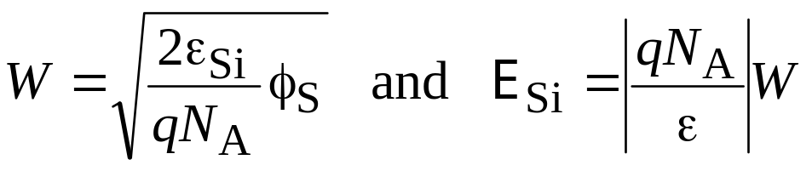
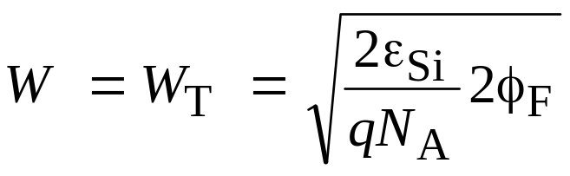
Delta depletion solution (cont.)
Consider p-type Si, depletion condition
Apply V_{G} such that φ_{s} < 2 φ_{F}
Charges in Si are immobile
ions - results in depletion
layer similar to that in pn
junction or Schottky diode.
M O S
p-Si
V_{G} > 0
|q N_{A} A W| = |Q_{M}|
(−) (+)
Q_{M}
w
Depletion of
holes
If surface potential is φ_{s} (with respect to
the bulk), then the depletion layer width W will be
E
E_{Si}
dE/dx = −qN_{A}/ε_{si}
x
At the start of inversion, φ_{s} = 2 φ_{F} and

Slide 8
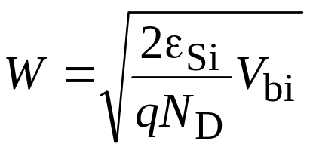
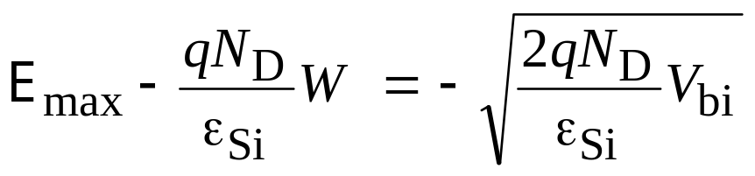
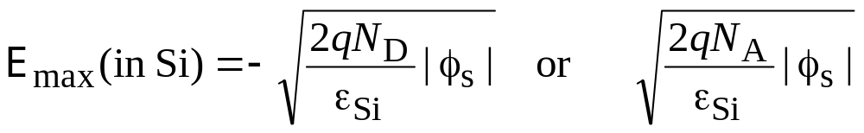
Depletion layer width, W and E-field
For a p⁺n junction, or a MS (n-Si) junction, the depletion layer width is given by:
Where V_{bi} is related to the amount of
band bending. V_{bi} in Volts is numerically
equal to the amount of band bending in eV.
For MOS, the same equation applies, except that V_{bi} is replaced by φ_{s.}
n-type
p-type

Slide 9
Delta depletion solution (cont.)
Consider p-Si, strong inversion.
M O S
p-Si
Once inversion charges
appear, they remain close to the surface since they are
mobile. Any additional
voltage to the gate results
in extra Q_{M} in gate and get compensated by extra
inversion electrons in
semiconductor.
V_{G}>>0
Q_{M}
w
Depletion of
holes
Inversion electrons:
δ-function-like
So, depletion layer does not have to increase to balance the charge
on the metal. Electrons appear as δ-function near the surface.
Maximum depletion layer width W = W_{T}

Slide 10
Gate voltage relationship
Applied gate voltage will be equal to the voltage across the oxide
plus the voltage across the semiconductor. Consider p-type Si.
V_{G}= Δφ_{ox} + Δφ_{Semi}
M O S
p-Si
V_{G} > 0
Δφ_{Semi} = φ(x = 0) − φ(bulk)
= φ_{S}
Δφ_{ox} = x_{ox} E_{ox}
Δφ_{ox}
Δφ_{Semi}
Since the interface does not have any charges up to inversion, we
can say that ε_{ox} E_{ox} = ε_{Si} E_{Si}
E_{ox} = (ε_{Si} / ε_{ox}) E_{Si}

Slide 11
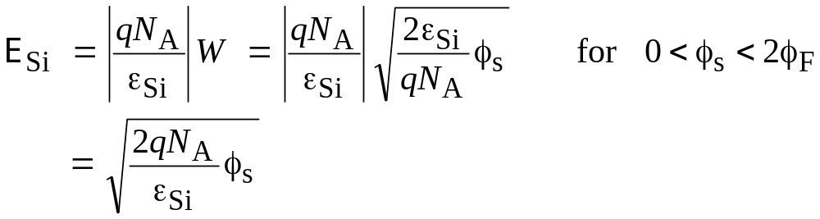
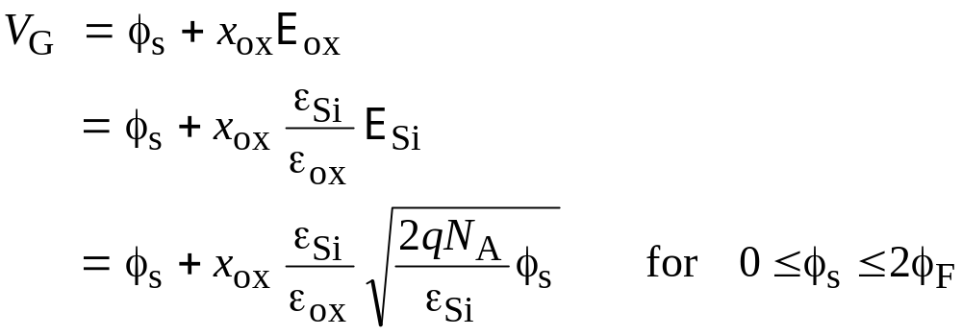
Gate voltage relationship (cont.)

Slide 12
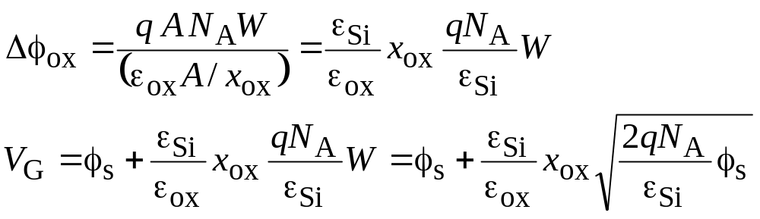
Gate-voltage relationship (Alternative method)
Consider p-type silicon
V_{G}= Δφ_{ox}+ Δφ_{Semi}
Δφ_{ox}= Q_{M}/C_{ox} = −Q_{s}/C_{ox} where C_{ox} is oxide capacitance and Q_{s} is the depletion layer charge in semiconductor
Q_{s} = −q A N_{A}W
C_{ox} = ε_{ox} A / x_{ox}
(same as before)

